Slide 1

Storing values in one variable
Indexed array

Slide 2
Objective
Learn about indexed arrays
Learn about associative arrays

Slide 3
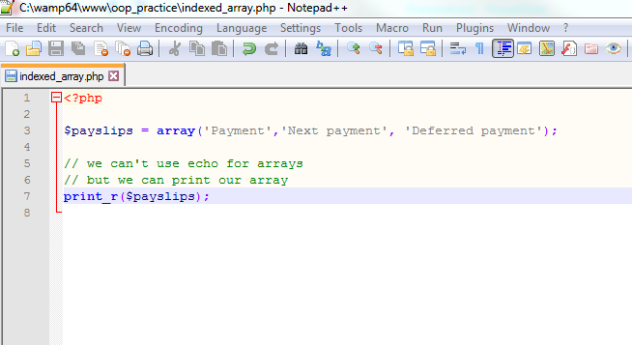

Indexed arrays

Slide 4
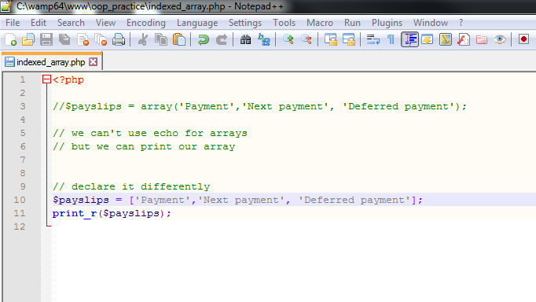

Another way

Slide 5
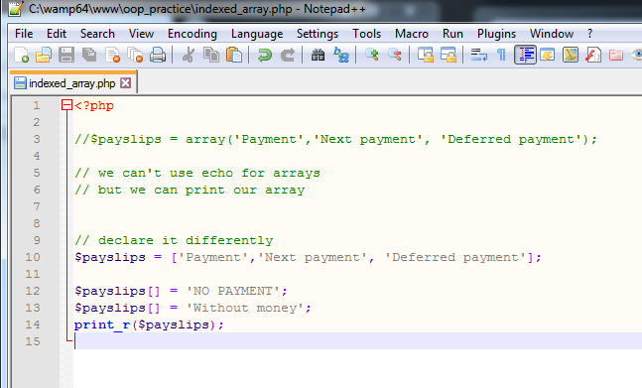

Let me add two more values in the array

Slide 6
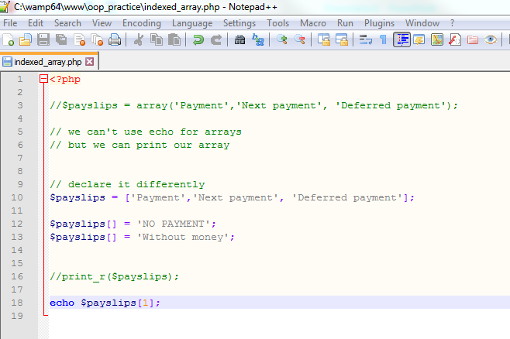

How about we use echo

Slide 7
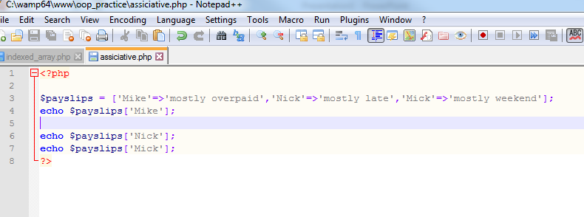

Associative array (array stores a set of key value pairs)

Slide 8
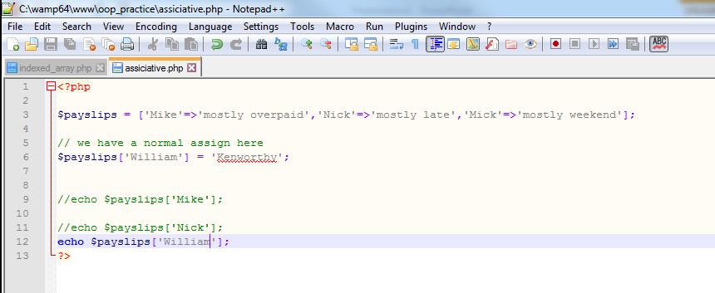

Add a new value ( key value)

